Slide 1
EEET2449 Research Methods for Engineers
Lecture 2: Practicing ‘Literature Review’ – Part 1
Dr. Francisco Tovar

Slide 2
Research Topics
Option 1: Select your favourite topic through the following link sent to your emails:
2018 Semester 2 Capstone Project topics list
Option 2: Select your favourite topic through the following Excel file sent to your emails:
Research Topics--Semester 2-2018.xlsx
Option 3: If you are interested in any other topic, which is not in the list, please check it with me via email

Slide 3
Part 1: Where to find papers?

Slide 4
Where to find papers?
Web of Science
https://pcs.webofknowledge.com/?Func=Exit
Scopus
http://www.scopus.com/
Google Scholar
http://scholar.google.com.au/
IEEE Explorer http://ieeexplore.ieee.org/Xplore/home.jsp
……

Slide 5
Where to find papers?
add the following address before the first slash of the link
.ezproxy.lib.rmit.edu.au
Web of Science
https://pcs.webofknowledge.com.ezproxy.lib.rmit.edu.au/
Scopus
http://www.scopus.com.ezproxy.lib.rmit.edu.au/

Slide 6
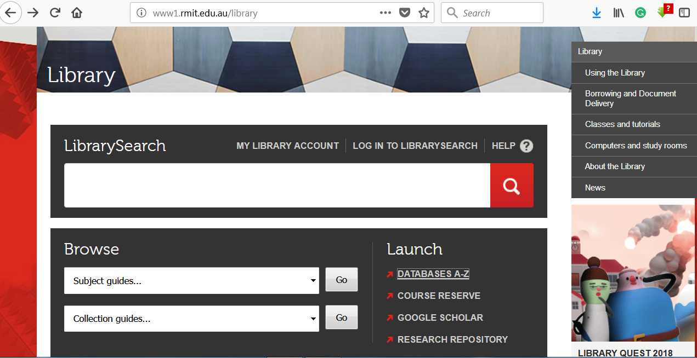
Where to find papers?
Go to RMIT library webpage:
http://www1.rmit.edu.au/library
Go to Databases A-Z:
http://www1.rmit.edu.au/browse;ID=lgqxifdcqvdgz

Slide 7
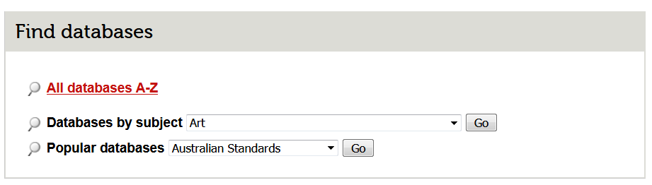
Where to find papers?
Go to Databases A-Z:
http://www1.rmit.edu.au/browse;ID=lgqxifdcqvdgz

Slide 8
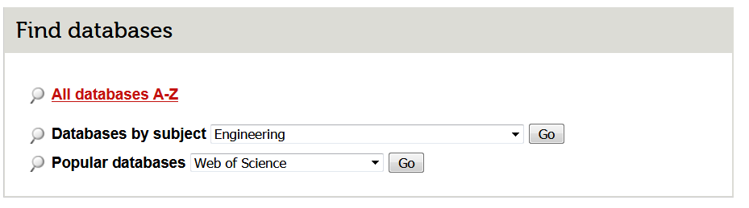
Where to find papers?
Select Engineering subject
Select Web of Science database

Slide 9
Part 2:
Let’s use “Web of Science” to find papers

Slide 10
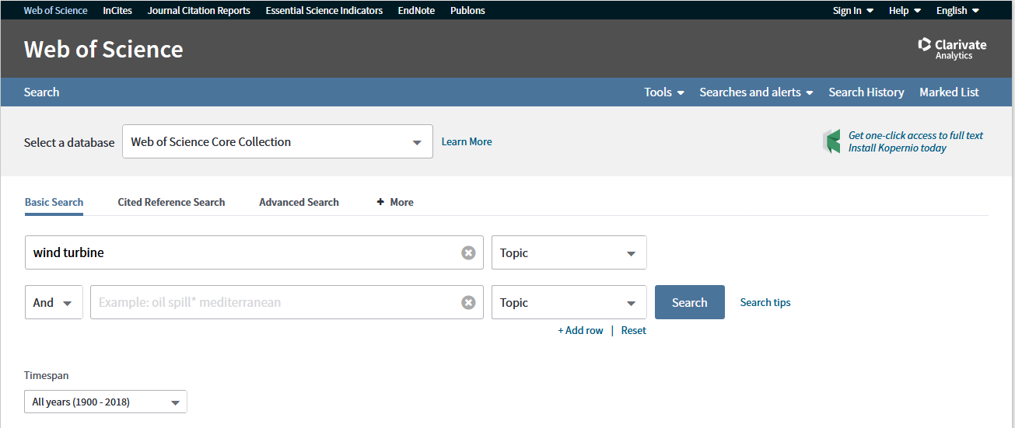
Let’s use “Web of Science” to find papers about: “Wind Turbines with Double fed generators”
(Semi variable speed generators)
Let’s try this keyword: “wind turbine”

Slide 11
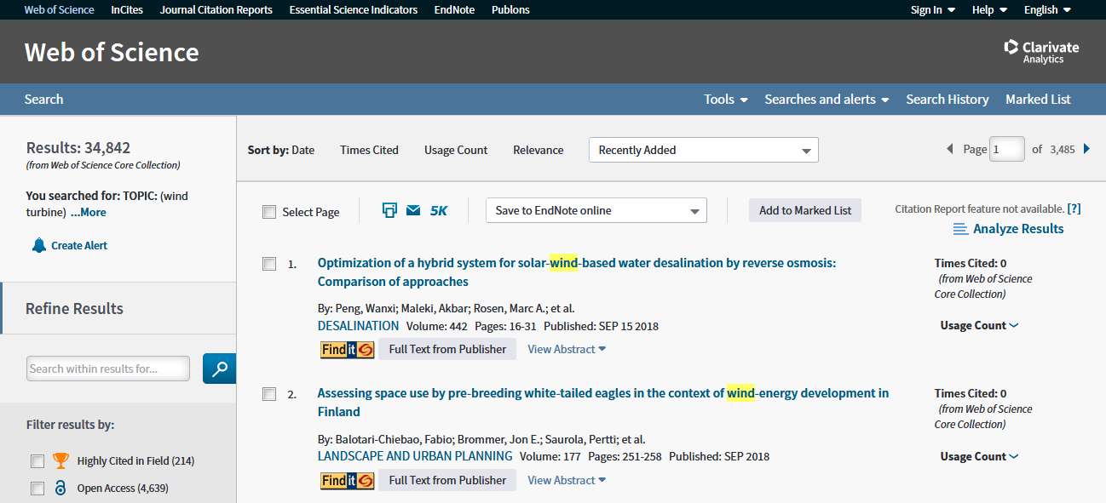
Let’s use “Web of Science” to find papers about: “Wind Turbines with Double fed generators”

Slide 12
Let’s use “Web of Science” to find papers about: “Wind Turbines with Double fed generators”
Wow!
38,842 papers are found !
Let’s narrow down our search

Slide 13
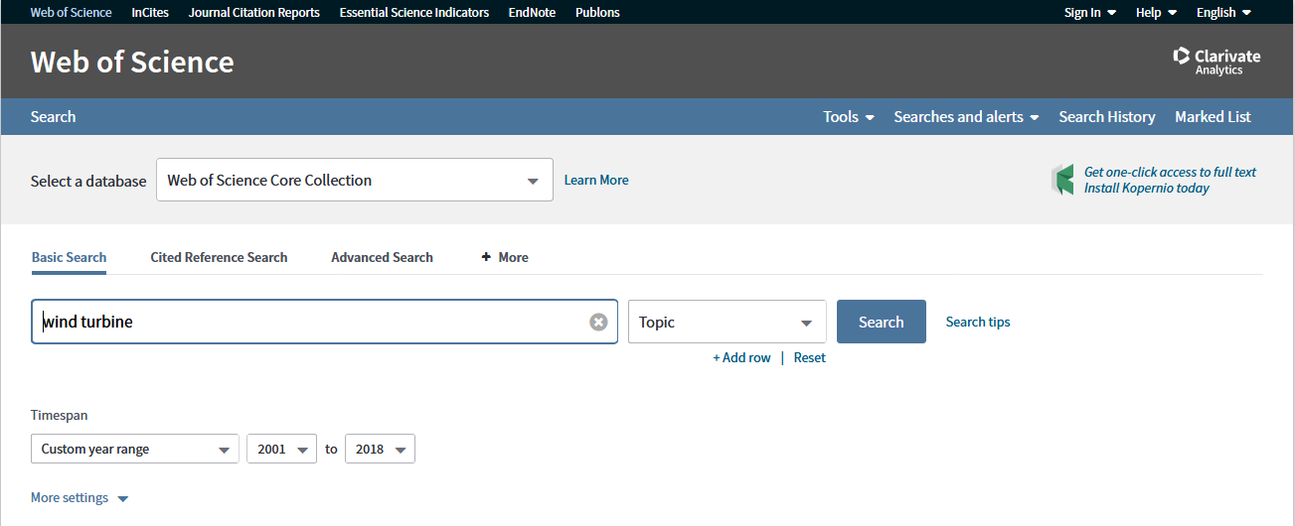
Let’s use “Web of Science” to find papers about: “Wind Turbines with Double fed generators”
Strategy 1:
Let’s limit the year of publication from 2001 to 2018
And search again

Slide 14
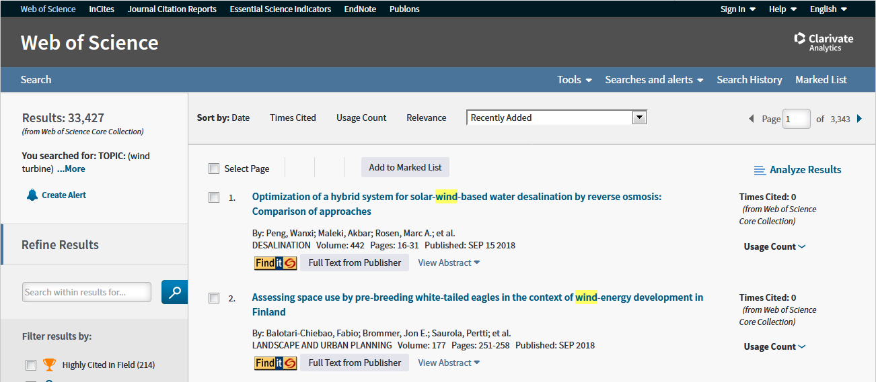
Let’s use “Web of Science” to find papers about: “Wind Turbines with Double fed generators”
Still 33,427 papers are found !
It really didn’t help !
Let’s further narrow down our search

Slide 15
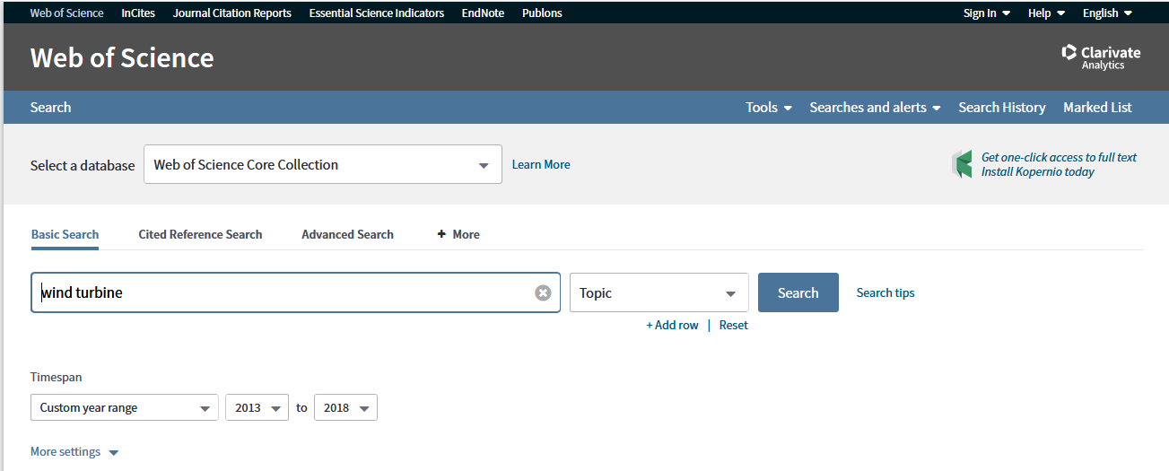
Let’s use “Web of Science” to find papers about: “Wind Turbines with Double fed generators”
Strategy 1:
Let’s limit the year of publication from 2013 to 2018
And search again

Slide 16
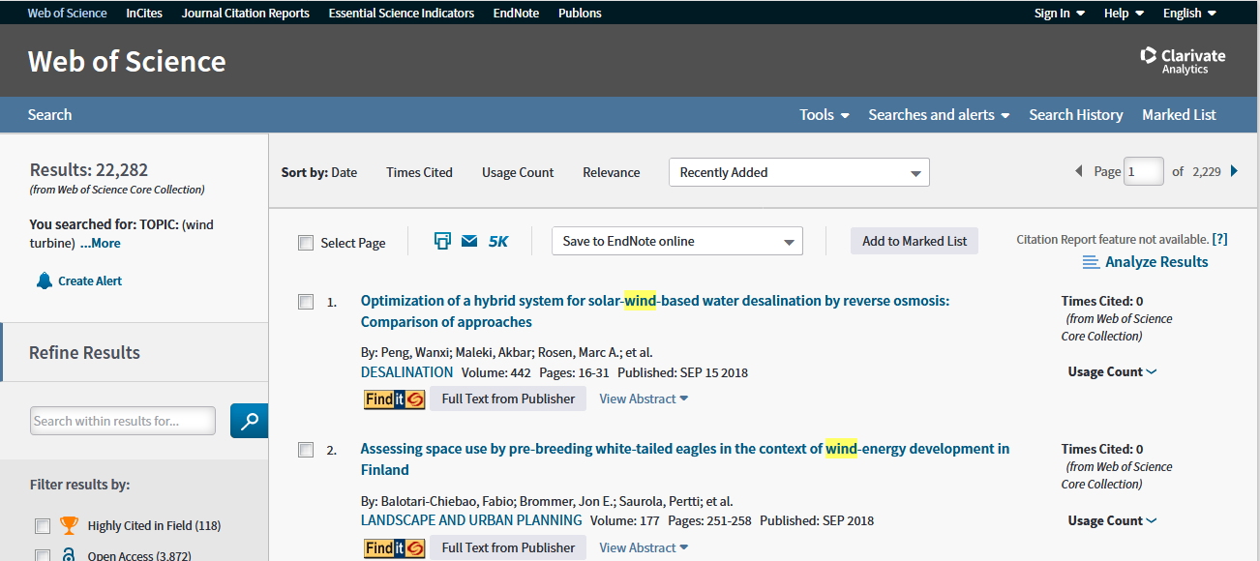
Let’s use “Web of Science” to find papers about: “Wind Turbines with Double fed generators”
Still 22,282 papers are found !
It really didn’t help !
Let’s further narrow down our search

Slide 17
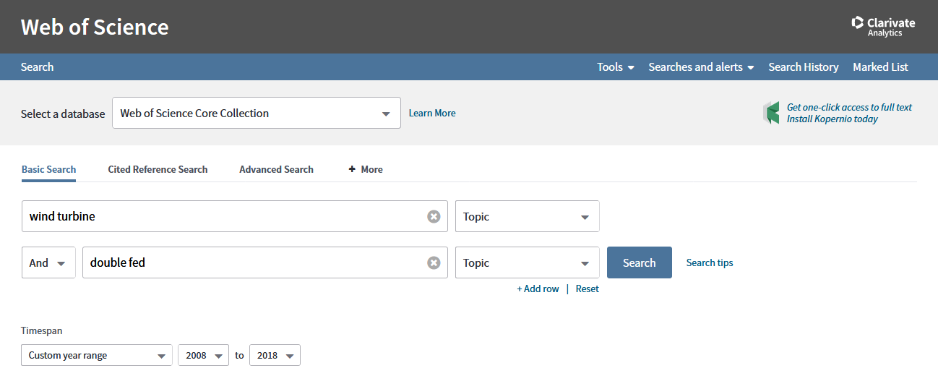
Let’s use “Web of Science” to find papers about: “Wind Turbines with Double fed generators”
Strategy 2:
Let’s add one more keyword:
“wind turbine” + “double fed”

Slide 18
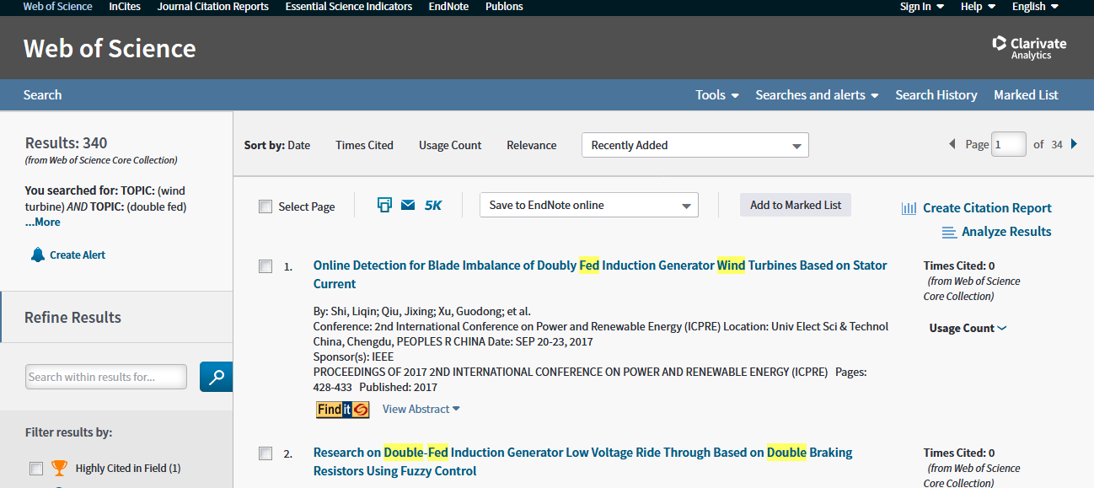
Let’s use “Web of Science” to find papers about: “Wind Turbines with Double fed generators”
Good !
We have only 340 papers !

Slide 19
Let’s use “Web of Science” to find papers about: “Wind Turbines with Double fed generators”
But I don’t know which paper is a
“key paper” !

Slide 20
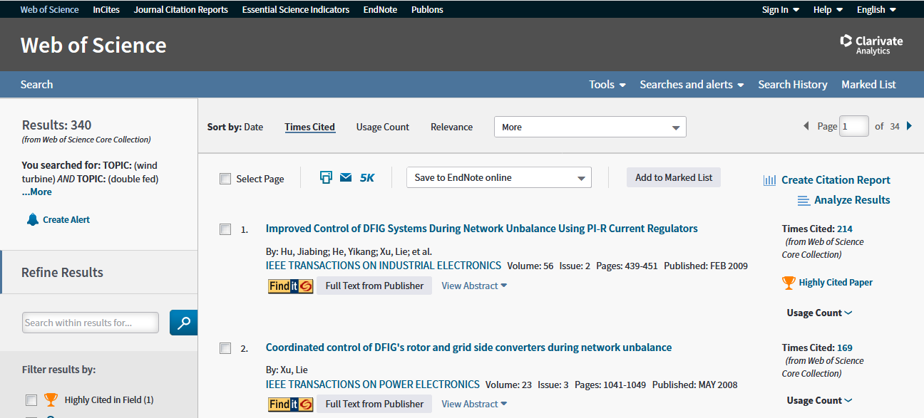
Let’s use “Web of Science” to find papers about: “Wind Turbines with Double fed generators”
Strategy 3:
Let’s rank the papers according to the number of citations

Slide 21
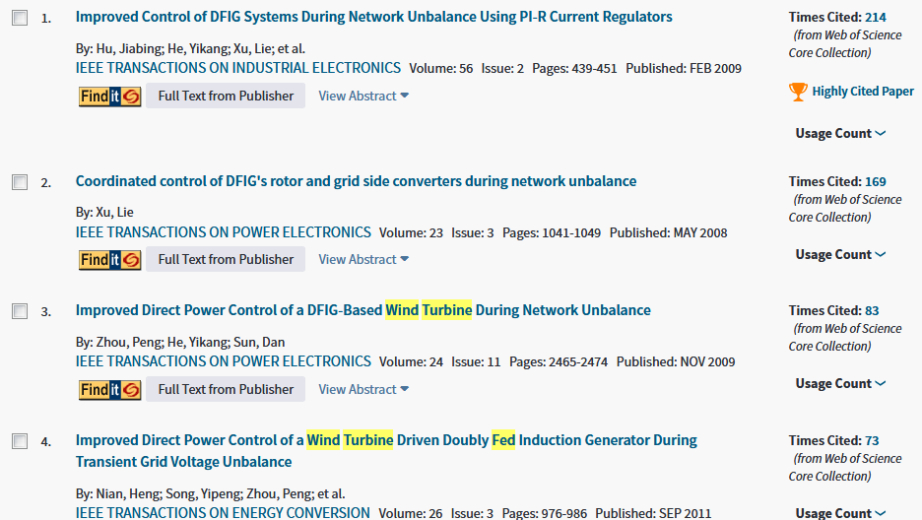
Let’s use “Web of Science” to find papers about: “Wind Turbines with Double fed generators”

Slide 22
Let’s use “Web of Science” to find papers about: “Wind Turbines with Double fed generators”
These papers are highly cited:
214 times since 2009
169 times since 2008
83 times since 2009
73 times since 2011
They should be “key papers”

Slide 23
Let’s use “Web of Science” to find papers about: “Wind Turbines with Double fed generators”
Also we have found the journals which publish those “key papers”

Slide 24
Let’s use “Web of Science” to find papers about: “Wind Turbines with Double fed generators”
Strategy 4:
Focus on top journals
IEEE TRANSACTIONS ON POWER ELECTRONICS
IEEE TRANSACTIONS ON ENERGY CONVERSION
IEEE TRANSACTIONS ON POWER SYSTEMS

Slide 25
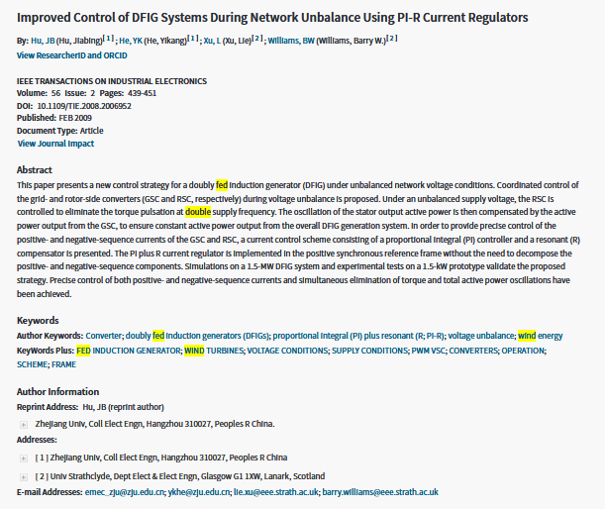
Let’s use “Web of Science” to find papers about: “Wind Turbines with Double fed generators”
Let’s have a closer look at the first “key paper”

Slide 26
Let’s use “Web of Science” to find papers about: “Wind Turbines with Double fed generators”
Maybe we can find some new keywords

Slide 27
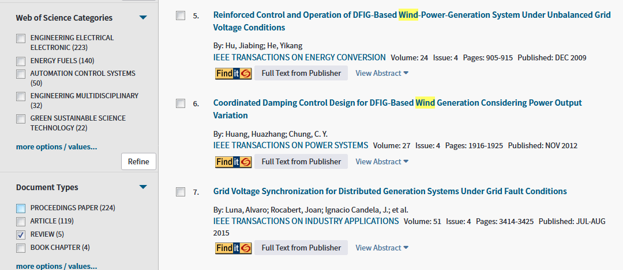
Let’s use “Web of Science” to find papers about: “Wind Turbines with Double fed generators”
Strategy 5:
Find some review papers !

Slide 28
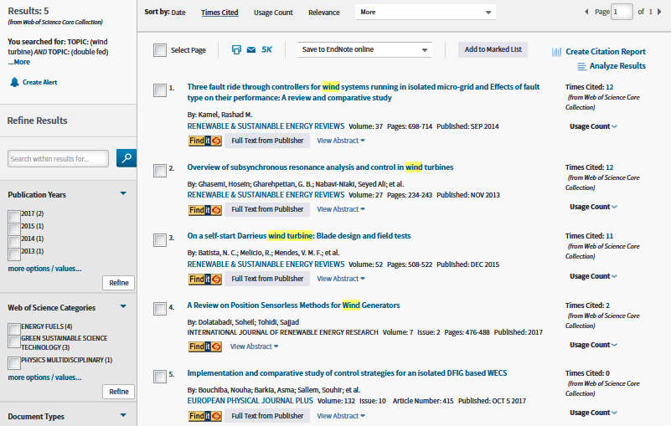
Let’s use “Web of Science” to find papers about: “Wind Turbines with Double fed generators”
I found 5 review papers !

Slide 29
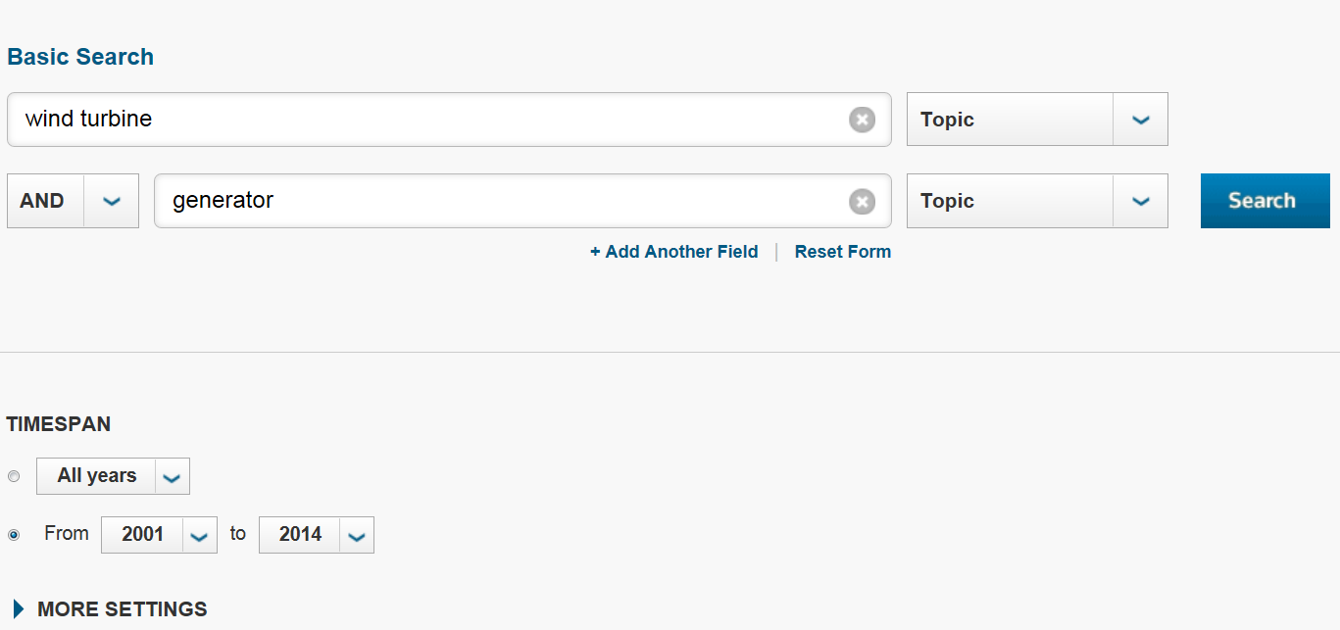
Let’s use “Web of Science” to find papers about: “Wind Turbines with Double fed generators”
Strategy 6:
Let’s try another set of keywords !

Slide 30
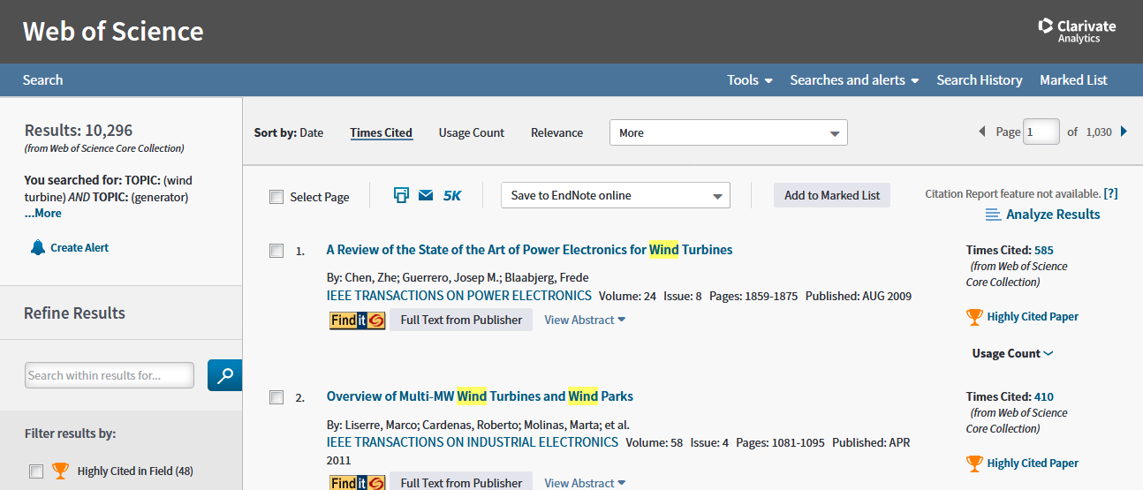
Let’s use “Web of Science” to find papers about: “Wind Turbines with Double fed generators”
Good !
We have 10,296 papers !

Slide 31
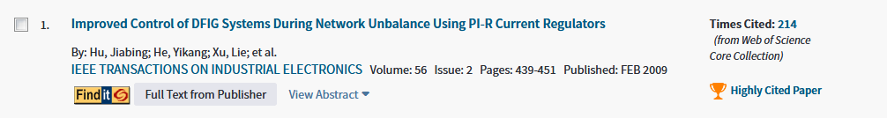
Let’s use “Web of Science” to find papers about: “Wind Turbines with Double fed generators”
Strategy 7:
Let’s take a look at the papers, which have cited this paper:
We might be able to find the frontier !

Slide 32
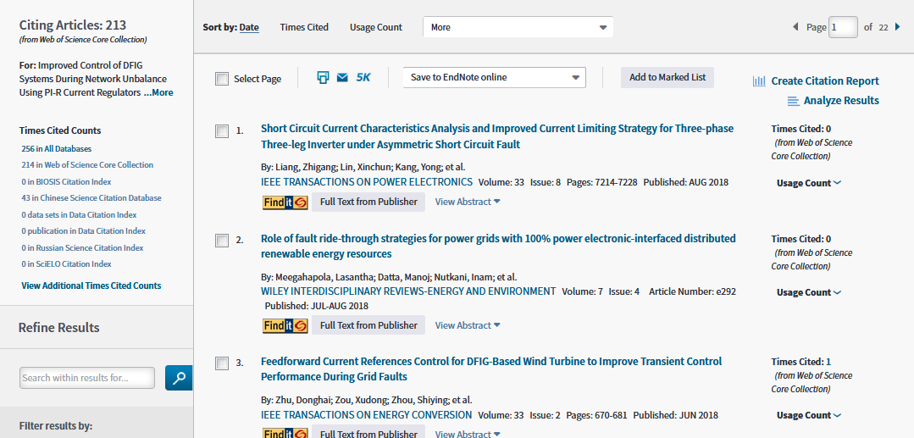
Let’s use “Web of Science” to find papers about: “Wind Turbines with Double fed generators”
213 papers found !
Let’s narrow down the number of papers

Slide 33
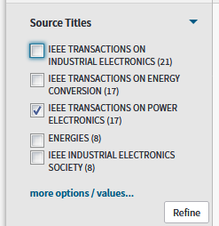
Let’s use “Web of Science” to find papers about: “Wind Turbines with Double fed generators”
Let’s select the papers in
IEEE TRANSACTIONS ON POWER ELECTRONICS

Slide 34
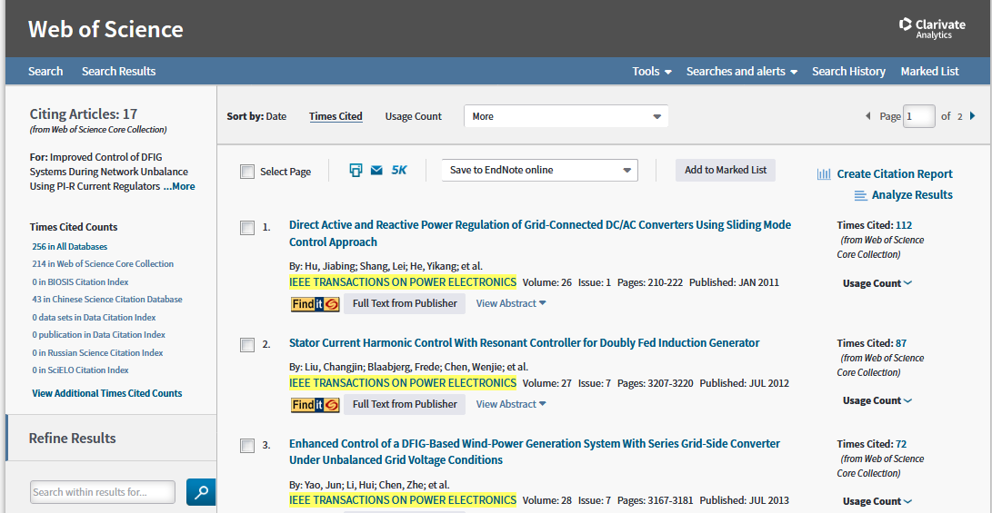
Let’s use “Web of Science” to find papers about: “Wind Turbines with Double fed generators”
It’s better !
Only 17 papers

Slide 35
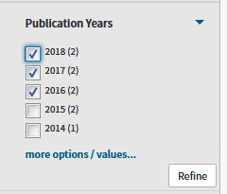
Let’s use “Web of Science” to find papers about: “Wind Turbines with Double fed generators”
2011 papers may direct you to the frontier …
But it is better to find papers published after 2016 !

Slide 36
Part 3:
Let’s summarise our ‘literature review’ strategies

Slide 37
Let’s summarise our strategies
Start with a keyword:
You will find lots of papers !

Slide 38
Let’s summarise our strategies
Strategy 1:
Limit your search to the past 10 years

Slide 39
Let’s summarise our strategies
Strategy 2:
Limit your search by adding more keywords

Slide 40
Let’s summarise our strategies
Strategy 3:
Limit your search by selecting highly cited papers
You might have found the
“key papers”

Slide 41
Let’s summarise our strategies
Strategy 4:
Focus on “Top journals”

Slide 42
Let’s summarise our strategies
Strategy 5:
Find some highly cited
review papers

Slide 43
Let’s summarise our strategies
Strategy 6:
Try another set of keywords
to have more “key papers”

Slide 44
Let’s summarise our strategies
Strategy 7:
Find the papers which have cited the “key papers”
You might have reached the frontier !

Slide 45
Let’s summarise our strategies
Strategy 8:
Check the references of your “key papers”
You might find more
“key papers”
Try strategy 7 again !

Slide 46
Part 4: Let’s record your selected papers

Slide 47
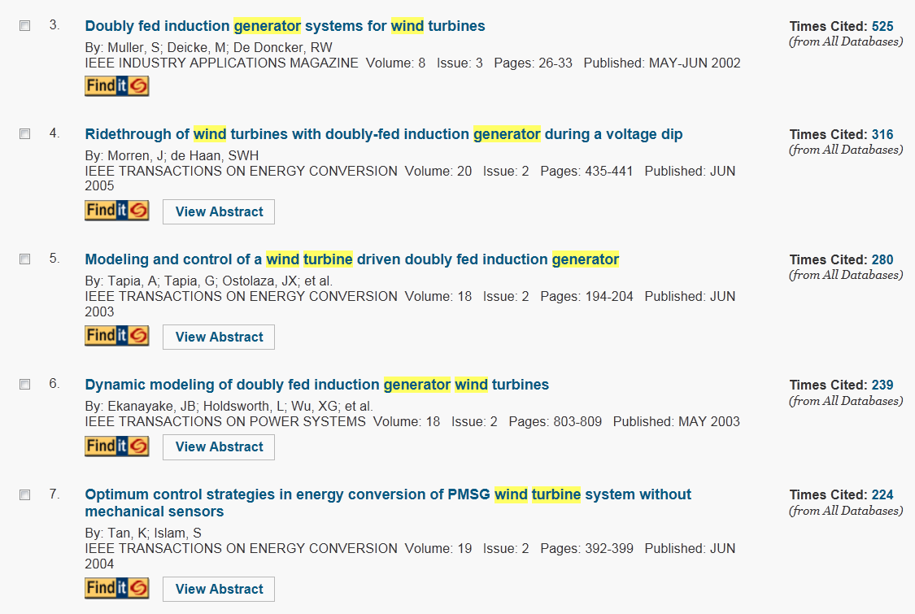
Let’s record the papers that we like
Go back to Web of Science….

Slide 48
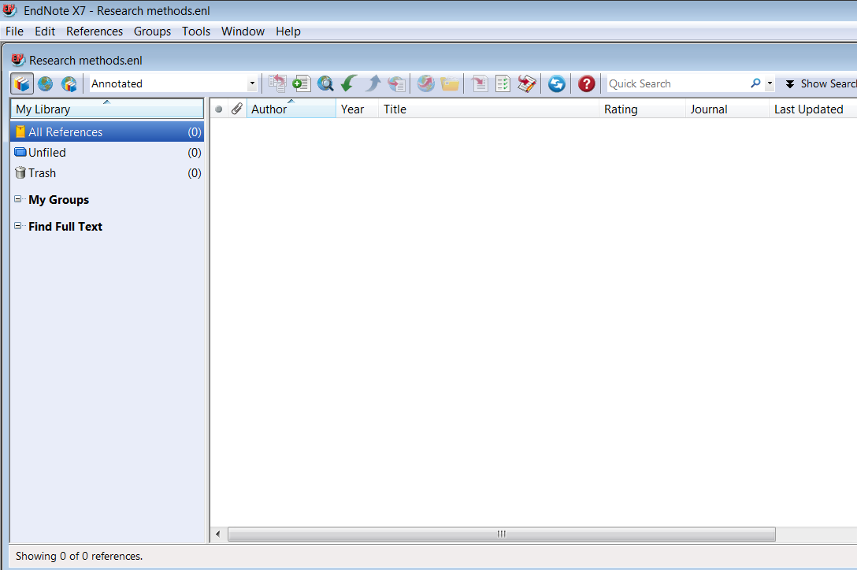
Let’s record the papers that we like
Open EndNote software

Slide 49
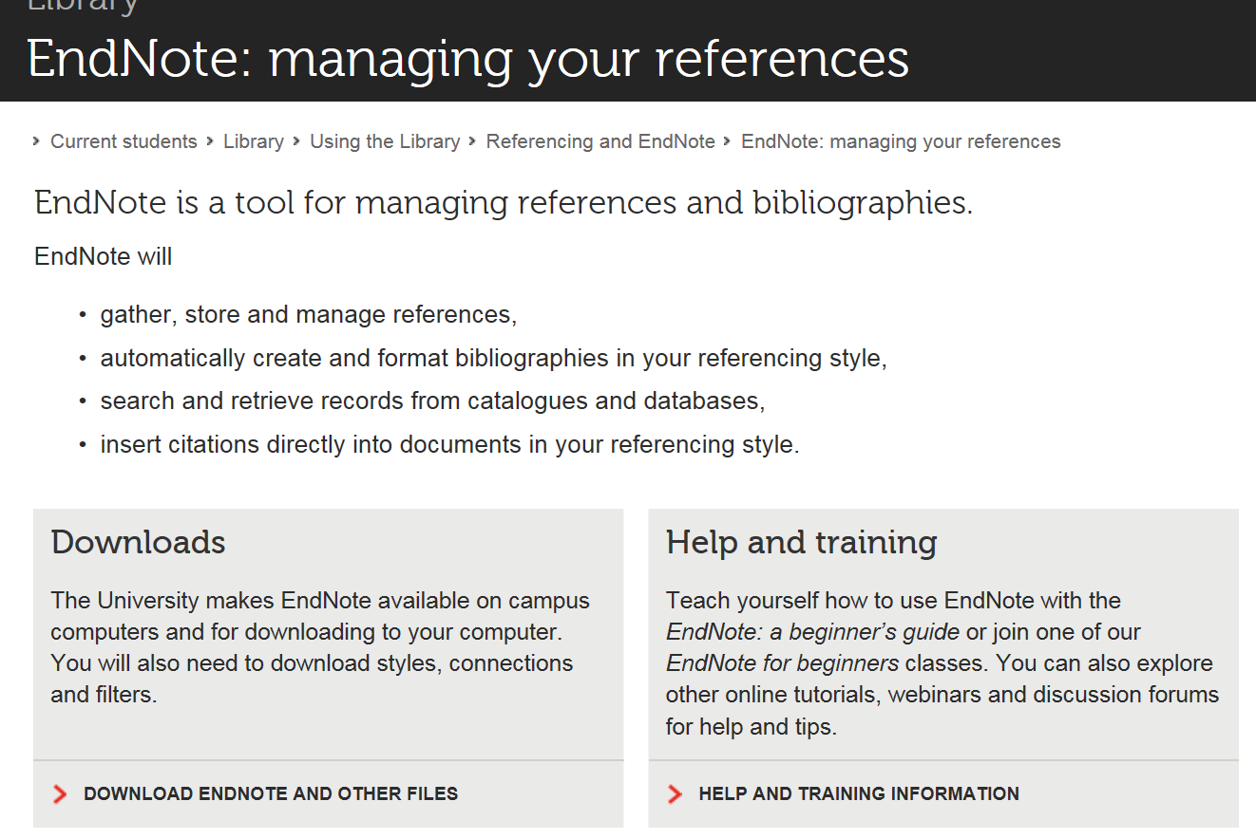
Let’s record the papers that we like
You can download Endnote through RMIT’s library https://www.rmit.edu.au/library/research/endnote-managing-your-references

Slide 50
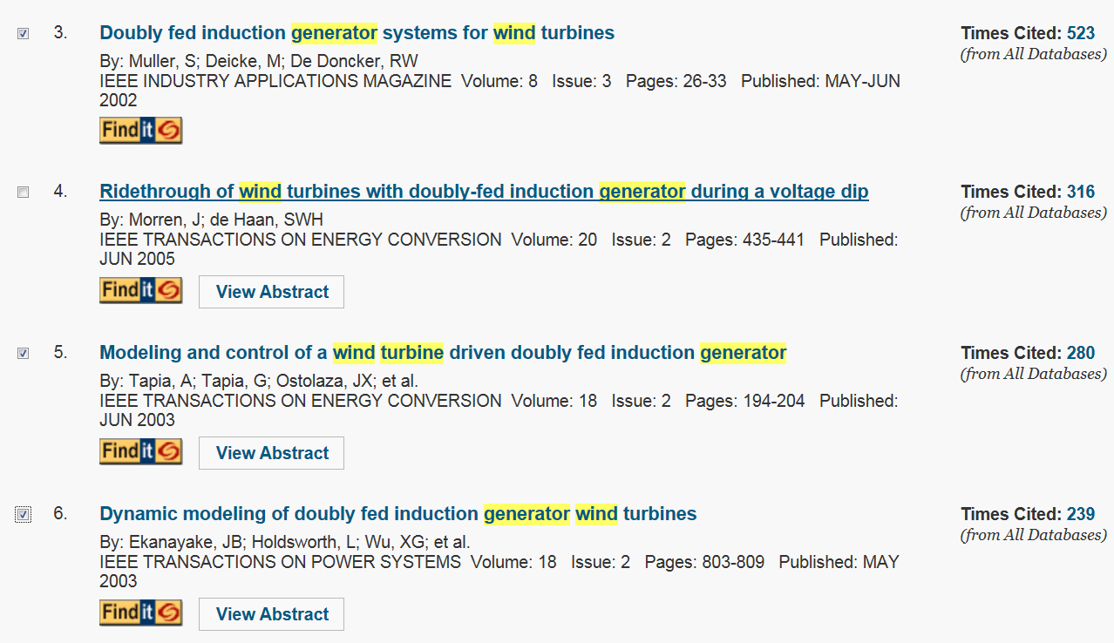
Let’s record the papers that we like
Select the papers by ticking them

Slide 51
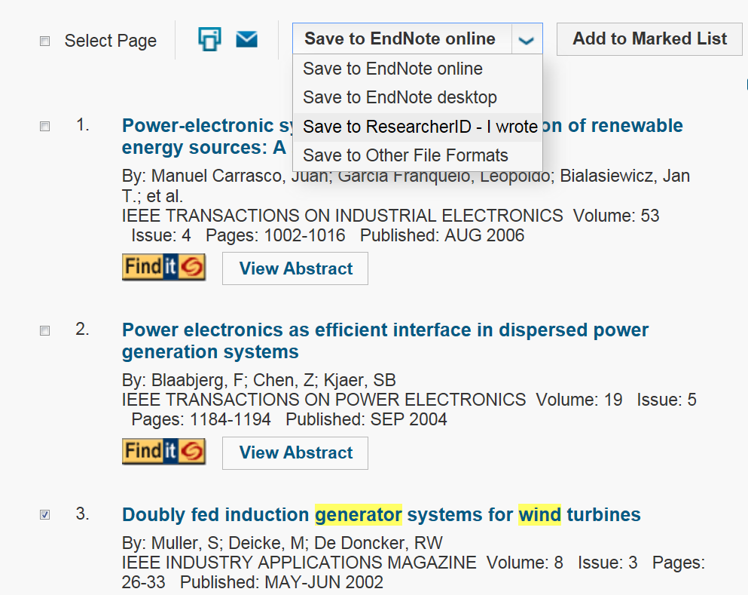
Let’s record the papers that we like
Select “Save to EndNote Desktop”

Slide 52
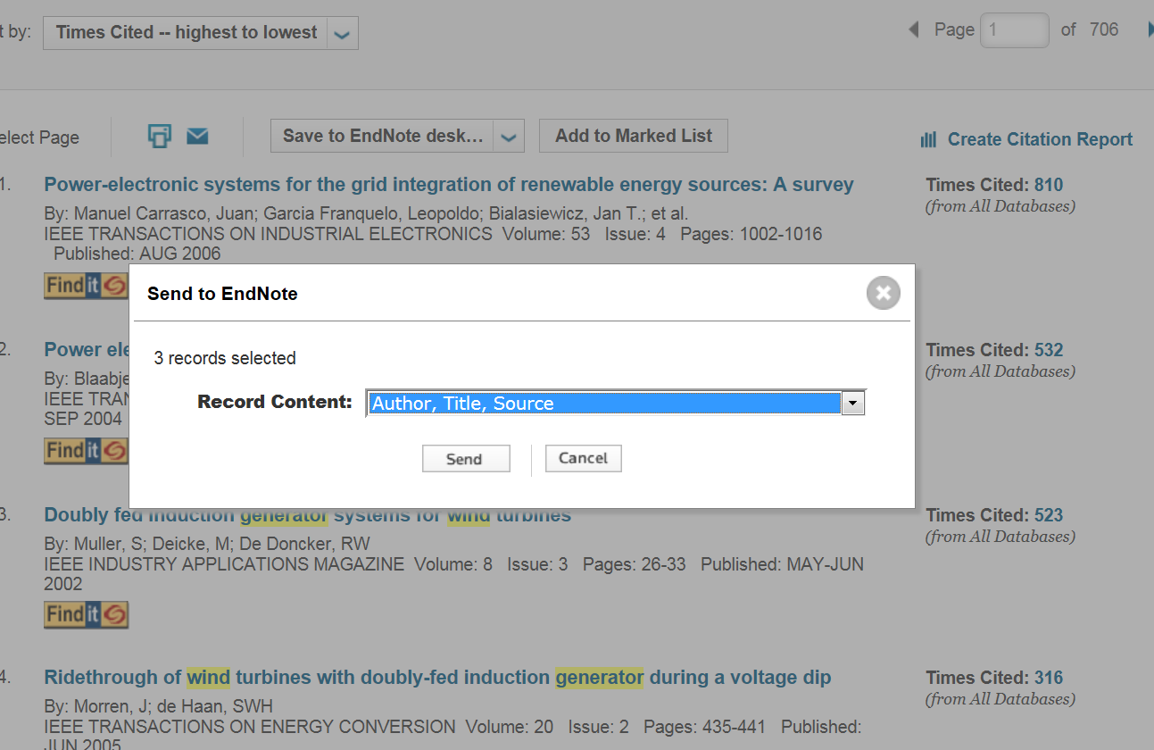
Let’s record the papers that we like
Select “Author, Title, Source”
Click “send”

Slide 53
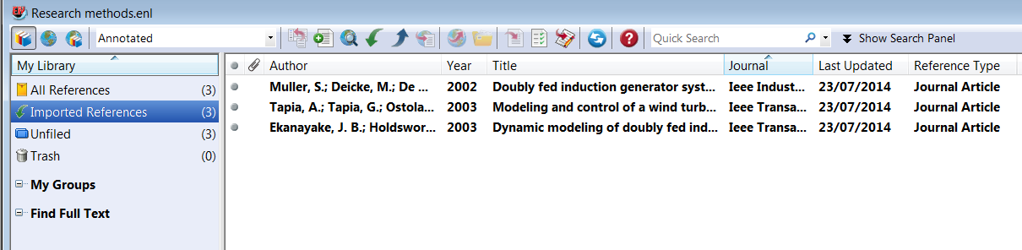
Let’s record the papers that we like
The selected references will be exported to EndNote

Slide 54
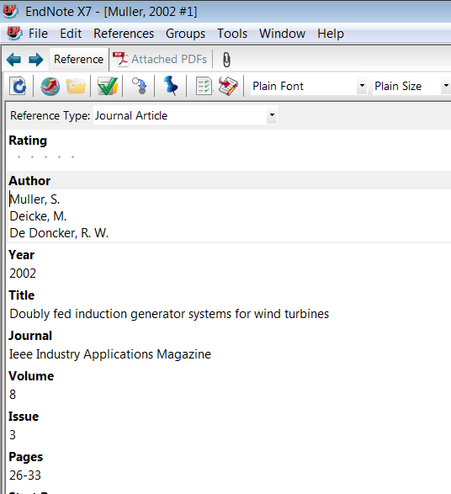
Let’s record the papers that we like
You can open any of them

Slide 55
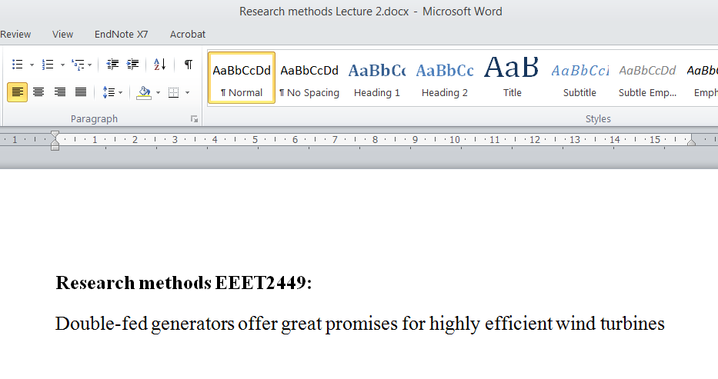
Let’s use the references in your literature survey:
Open your Word file, and write what you want:

Slide 56
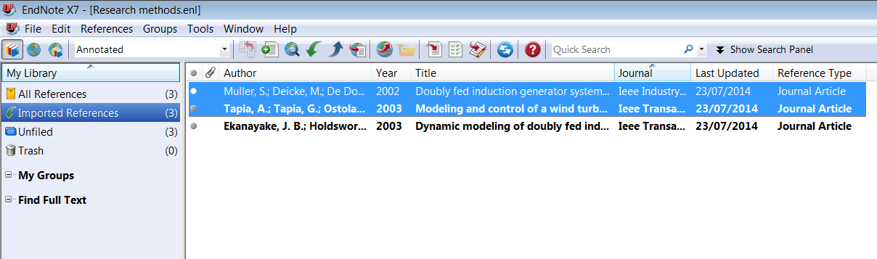
Let’s use the references in your literature survey:
Select the required references in EndNote

Slide 57
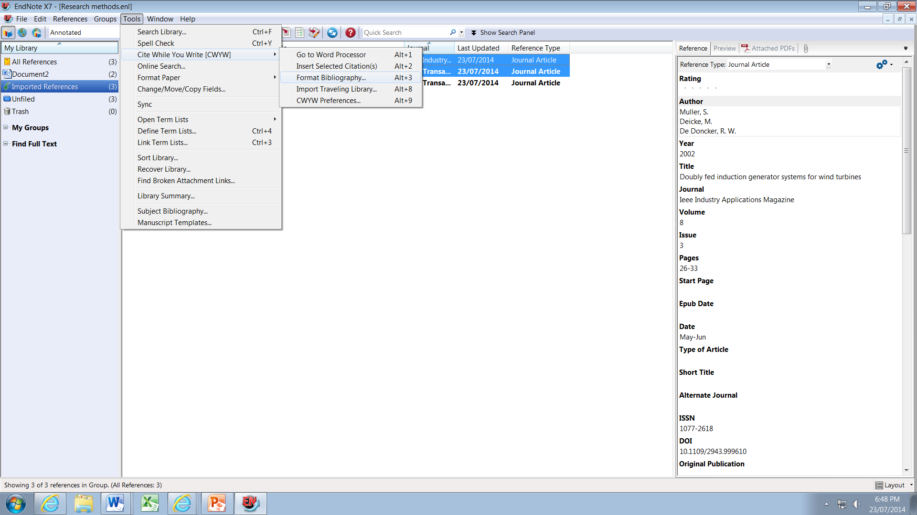
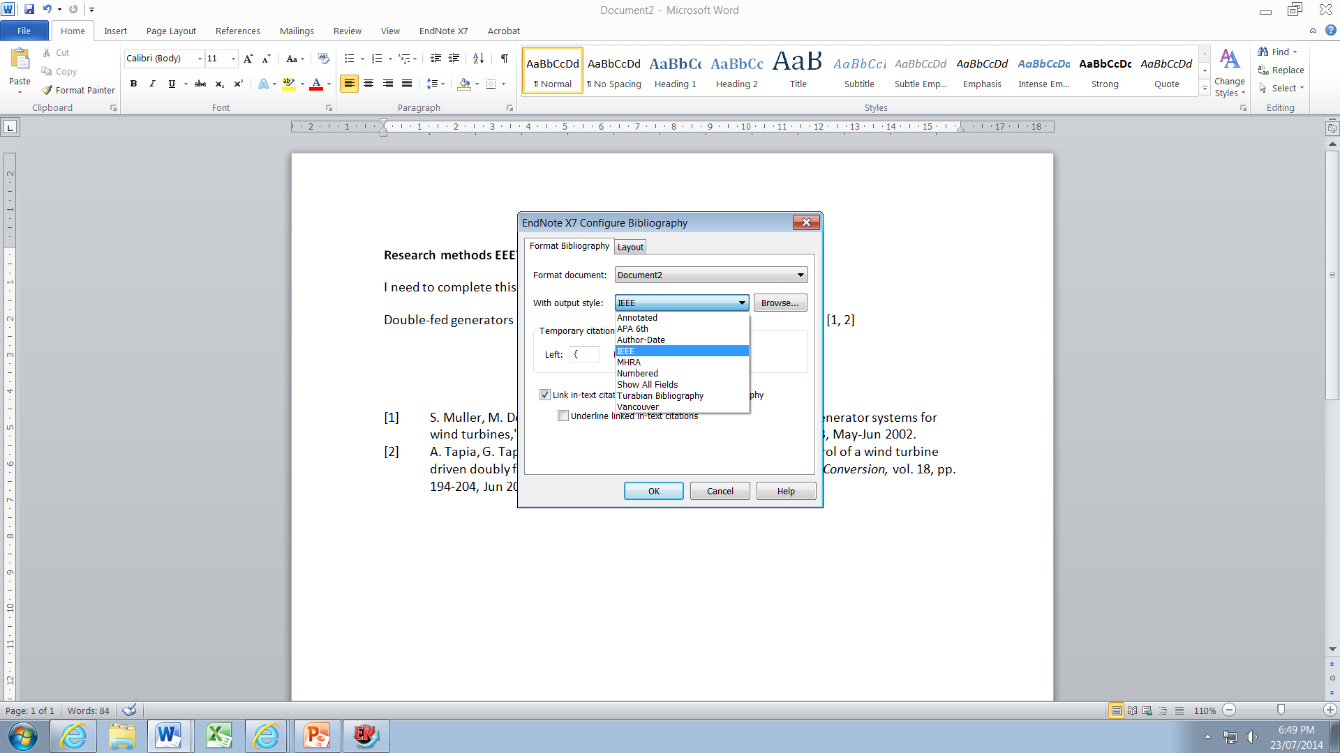
Let’s use the references in your literature survey:
Select the IEEE format for exporting the references:
Tools/ Cite While You Write/ Format Bibliography/
With output style/ IEEE

Slide 58
Let’s use the references in your literature survey:
Press “Alt” + “2” wherever you like to cite the paper in your report:

Slide 59
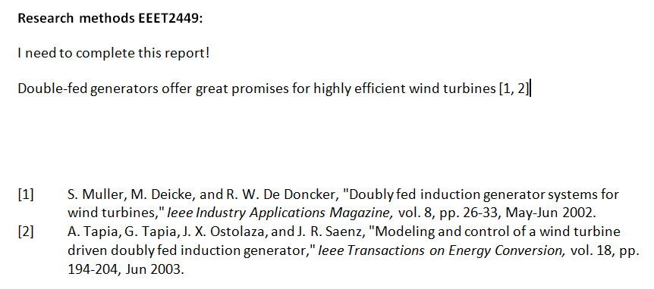
Let’s use the references in your literature survey:
References [1, 2] are added
Bibliographic information of references [1, 2] is added at the end of the file

Slide 60
Next week …..
We will practice more on literature survey
Week 3: Practicing ‘Literature Review’ – Part 2

